Slide 1
How to Create a Profile—for Academia

Slide 2
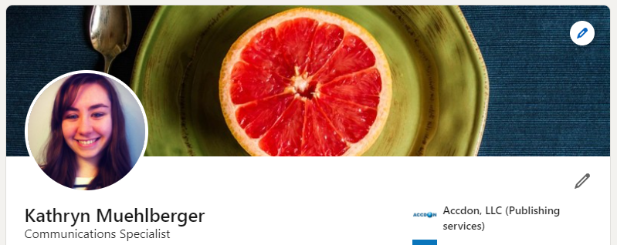
Getting Started – Basic Information
Profile photo with good lighting from the past 5 years.
Background cover photo that represents your research or other professional interests.
Headline of your current position or a more encompassing title that covers all your responsibilities.
Background photo
Profile photo
John Smith
Associate Editor
Headline

Slide 3
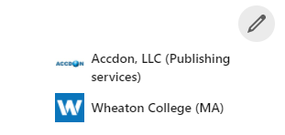
Location and Current Affiliation
Showing your location is optional but listing it will show a more complete profile and connect you with other researchers in close proximity.
You can revise your privacy settings if you are uncomfortable about revealing your location.
You can also list a general area, like Greater Boston or Shanghai.
Add your current department and university (or company), as well as position.
Current affiliation
John Smith
Associate Editor
Greater Boston, Massachusetts, United States
Location

Slide 4
About You
Include an informative sentence (or two) that describes you and your research.
For example, “A track record in experimental physiology. Extensive experience in academic publishing. The desire to further efficacy and innovation in scientific communications.”
Add your personal website if applicable (see ‘Featured’ section below ‘About’).

Slide 5
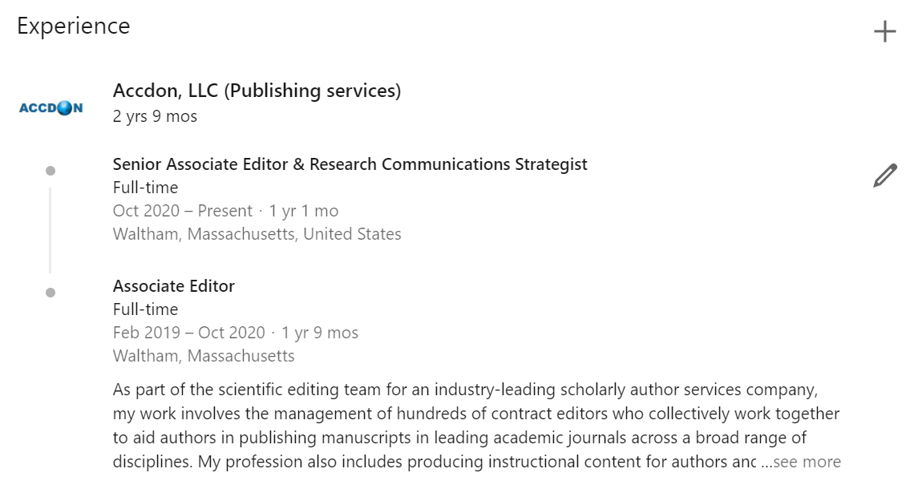
Work Experience
Add all employment positions from the last 10-20 years. Only include positions that are relevant to your professional experience.
Highlight the most important aspects of the position.
All previous employment should be written in past tense.
Include multiple positions if you have been promoted at your current affiliation

Slide 6
Education
Add your undergraduate and post-graduate institutions with the corresponding year(s) and major(s)/minor(s). If you held a job during school and it is relevant to your current position, then you can add a short description.
List any accomplishments you may have made, such as honors or awards received, funding attained, laboratory experience, or undergraduate research capstones.

